Slide 1

Codecool Dungeon Quest
2nd Sprint 09 - 13 March 2020
Developed by Harnet

Slide 2
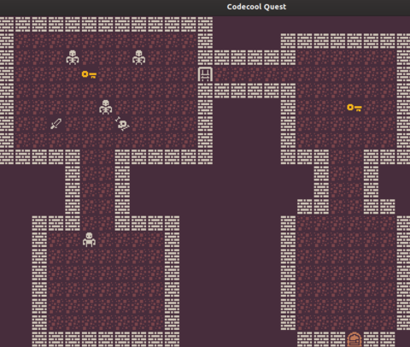
Game process
2nd Sprint plan
Mobs should move independently from player movements
Create a new level map
Player can go through an exit door to a new level
Create new type of monster with different behavior
Refactor the existing code to MVC model as deep as it possible

Slide 3
Planning of a second sprint week workflow according to backlog
Refactoring of the existing code for suiting to MVC model structure
It’s the Presentation Day!
Monday
Tuesday
Wednesday
Thursday
Friday
Giving to mobs a possibility to move independently from user moving
Creating a new level map and giving a possibility to player to go there

Slide 4


Used technologies:

Slide 5
Demonstration of Game Process

Slide 6
Challenges
MVC model structure
Code refactoring
Java FX isn’t so good for MVC model

Slide 7
Plans on the future sprint
AI for monsters movements
New types of monsters with different appearance, behavior and damage
Grocery store with goods, food and alcohol
More interesting maps and levels

Slide 8
Questions and advice
Harnet mail to: nullPointerException

